Slide 1
ZARA ESCAPES CENTRALIZED FEEDBACK SYSTEM
Presented by: Ebuka Anthony Akunedoziobi

Slide 2

Project Overview
Zara Escapes Luxury hospitality brand with 20 properties
Goal: Centralize guest feedback & improve customer experience
This project aims to design a centralized, data-driven system that consolidates all guest feedback into one unified platform. Over the course of three weeks, this project will focus on structural analysis, design, and solution recommendations to create a modernized feedback management framework.
Key Objectives
Centralize all guest feedback into a unified system accessible across all 20 properties.
Monitor customer sentiment in real time to support proactive issue resolution.
Identify recurring service issues and trends using clear reporting and analytics.
Enable faster response times through automated alerts and streamlined workflows.
Support better decision-making with accurate, up-to-date data insights.
Improve overall guest satisfaction and service consistency.
Notes:
Introduce Zara Escapes, its luxury positioning, and why guest feedback is critical to service excellence.

Slide 3

Business Challenges
Fragmented feedback, delayed responses, limited insight
This analysis revealed several key challenges affecting Zara Escapes ability to manage customer feedback effectively:
1. Fragmented Feedback Channels
2. Limited Analytical Visibility
3. Delayed Response Times
4. Inefficient Follow-Up Processes
5. Lack of Comprehensive, Actionable Reporting
Business Impact
These challenges outlined above collectively hinders Zara Escapes ability to deliver consistent, responsive, and insight-driven service. The company risks losing opportunities for proactive guest engagement, slowing down issue resolution, and missing long-term improvement trends. As the brand grows, these inefficiencies may undermine the consistency of its luxury service standards.
Notes:
Explain the fragmented feedback problem and how it affects response time and guest satisfaction.

Slide 4
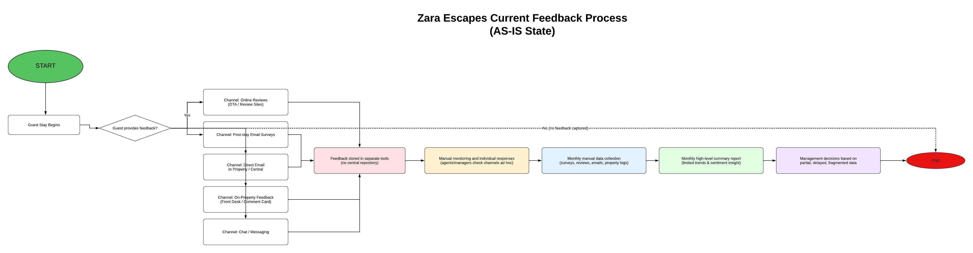
AS-IS Process
Transition from manual, reactive feedback management to automated workflows
The current feedback management process at Zara Escapes is highly fragmented, manual, and inconsistent, limiting the company’s ability to deliver timely, data-driven service improvements.
Below are some of the pain points and inefficiencies I have highlighted:
1. Fragmented Feedback Channels
2. No Real-Time Monitoring
3. Manual and Time-Consuming Reporting
4. Lack of Standardized Workflow
Notes:
Walk through the gap between current AS-IS processes and the desired TO-BE state.

Slide 5
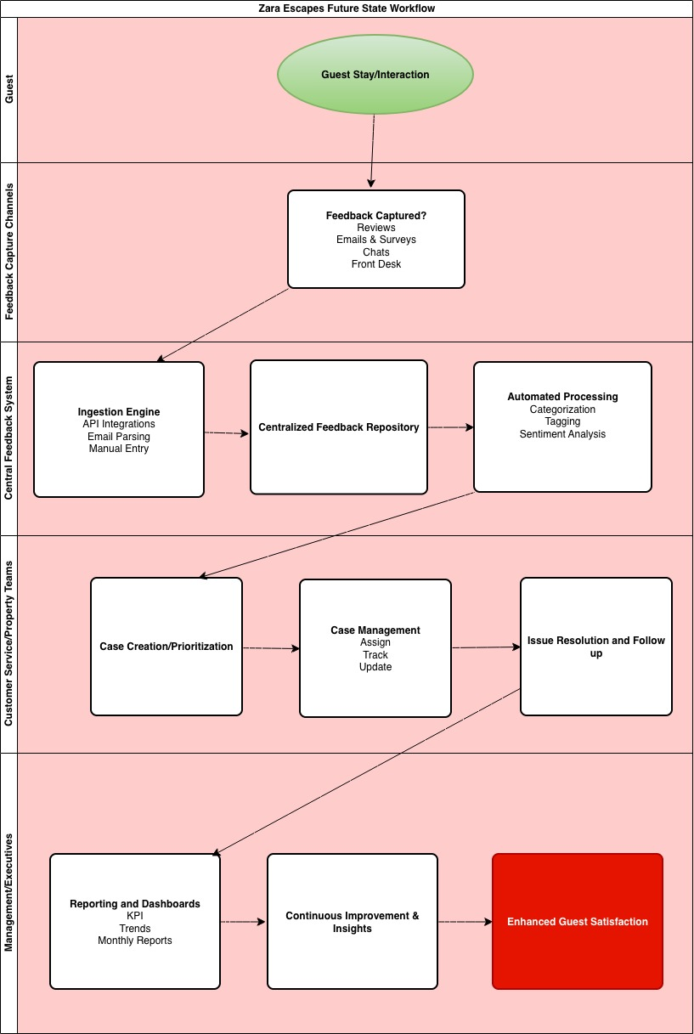
TO-BE Feedback Workflow
Multi-channel intake → analysis → alerts → resolution → reporting
The new TO-BE workflow transforms Zara Escapes’ feedback management from a fragmented, reactive process to a centralized, automated, insight-driven system.
1. Improved Responsiveness
2. Standardized Workflows Across All Properties
3. Stronger Insights for Decision-Making
4. Better Guest Experience
5. Long-Term Organizational Benefits
Overall, the TO-BE workflow enhances customer satisfaction, operational efficiency, and strategic decision-making.
Notes:
Explain the end-to-end TO-BE workflow from feedback intake to reporting.

Slide 6
GAP ANALYSIS
The gap analysis clearly demonstrates that Zara Escapes’ current feedback process:
Is manual, slow, and fragmented
Lacks real-time insight and consistent accountability
Cannot scale across 20 properties
The future TO-BE system solves these challenges by introducing:
Automation
Centralization
Real-time intelligence
Standardized workflows
Data-driven decision-making
Area | AS-IS Gap | TO-BE Improvement | Business Impact
Centralization | No unified system | Single Centralized Platform | Eliminates Fragmentation
Response Time | Slow, manual, delayed | Real-time alerts & automation | Faster issue resolution
Data Analysis | Limited, manual, monthly | Automated insights & dashboards | Data-driven decisions
Approach | Reactive | Proactive | Improved guest satisfaction
Workflow | Inconsistent | Standardized lifecycle | Higher accountability
Scalability | Not scalable across 20 properties | Designed for enterprise scale | Supports expansion
Reporting | Manual summaries | Automated reports | Reduces labor + error risk

Slide 7

System Features
Central repository, alerts, case management, dashboards
Centralization module - which consolidates guest feedback from multiple channels—surveys, emails, online reviews, and on-property interactions—into a single, unified repository.
Alerts & Case Management module - ensures feedback is actionable. Time-sensitive or negative feedback triggers real-time alerts and is converted into trackable cases with defined ownership and priority.
Dashboard Module - provides role-based analytics for executives, operations, and property managers.
Notes:
Highlight the core modules that make the system functional and scalable.

Slide 8
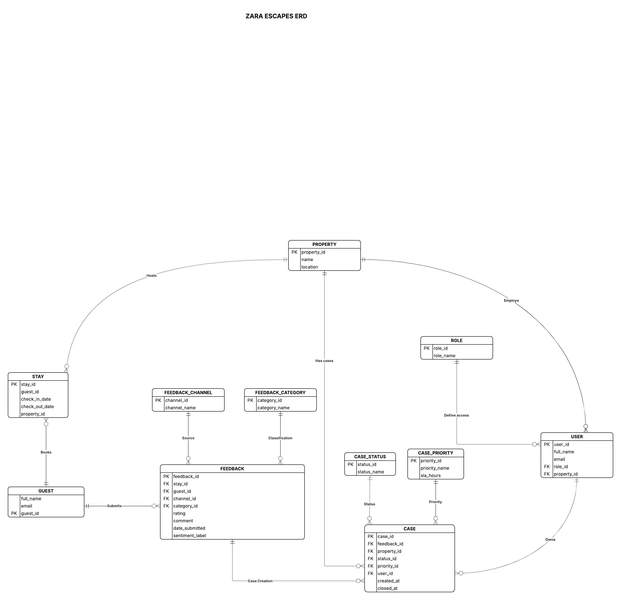
Data & Architecture Design
ERD, CRUD matrix, scalable integration architecture
The CRUD matrix ensures that every entity in the centralized feedback system has a clearly defined lifecycle, with controlled creation, broad visibility, governed updates, and restricted deletion to support data integrity, accountability, and compliance across all properties.
 |  | Zara Escapes CRUD Matrix
 | Entity | Description | Create (C) | Read (R) | Update (U) | Delete (D)
 | GUEST | Customer who stays and provides feedback | System, Agent | Agent, PM, Ops, Exec | Agent, Admin | Admin (GDPR/compliance)
 | PROPERTY | Hotel / resort location | Admin | All roles | Admin, Ops | Admin (rare)
 | STAY | Guest stay at a property | System, Agent | Agent, PM, Ops, Exec | System, Admin | Admin (archive preferred)
 | FEEDBACK | Guest feedback record | System, Agent | Agent, PM, Ops, Exec | Agent, PM, System | Admin (compliance only)
 | FEEDBACK_CHANNEL | Source of feedback | Admin, System | All roles | Admin | Admin (deactivate preferred)
 | FEEDBACK_CATEGORY | Feedback classification | Admin, Ops | All roles | Admin, Ops | Admin (if unused)
 | CASE | Actionable ticket | System, Agent | Agent, PM, Ops, Exec | Agent, PM, Ops, System | Admin (archive preferred)
 | CASE_STATUS | Workflow status | Admin, Ops | All roles | Admin, Ops | Admin (if unused)
 | CASE_PRIORITY | Priority with SLA | Admin, Ops | All roles | Admin, Ops | Admin (if unused)
 | RESPONSE_ACTION | Case resolution actions | Agent, PM, Ops | Agent, PM, Ops, Exec | Agent, PM, Admin | Admin only
 | ALERT | System alerts | System | Agent, PM, Ops | Agent, PM, System | Admin only
 | USER | Internal system users | Admin, System | All roles (limited) | Admin, User (self) | Admin only
 | ROLE | Permission roles | Admin | Admin, Ops | Admin | Admin (if unused)
 | TEAM | Operational teams | Admin, Ops | All roles | Admin, Ops | Admin (deactivate pref.)
Notes:
Explain how data modeling and architecture support reliability and growth.

Slide 9
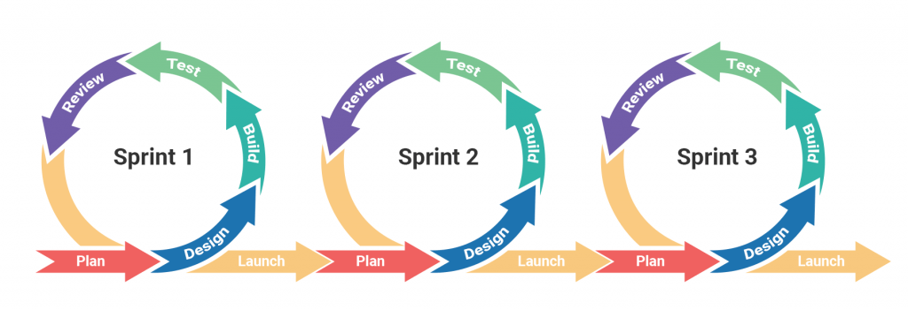
Agile Delivery Model
Epics, stories, sprints over a 3-week timeline
Agile delivery helped me balance structure with adaptability. It provided a disciplined framework for planning and execution, while still allowing the solution to evolve based on real user feedback. This approach ensured the project was delivered on time, aligned with business objectives, and ready for implementation.
Notes:
Describe how Agile delivery enabled structured and timely execution.

Slide 10
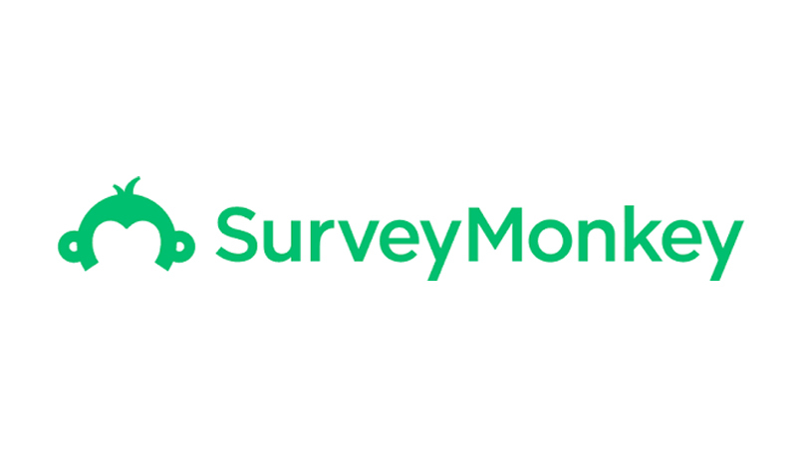
Tool Recommendation
SurveyMonkey selected using cost–benefit analysis
SurveyMonkey offers the best balance of functionality, cost, and scalability—meeting all critical business needs without the overhead of enterprise CX platforms.
SurveyMonkey was selected as the preferred feedback collection tool for Zara Escapes because it delivered the best balance of functionality, cost efficiency, scalability, and integration capability when compared with alternatives such as Google Forms, Qualtrics, and Medallia.
Notes:
Explain why SurveyMonkey was selected based on cost-benefit analysis.

Slide 11
Integration Roadmap
Feedback system integrated with PMS, CRM, BI
Phase 1
Foundation & Planning
Audit systems Define data rules Design architecture
Phase 2
Data Mapping & Design
Map fields Define APIs Validate mappings
Phase 3
Integration Build
Survey ingestion PMS sync CRM updates
Phase 4
Testing & Go-Live
UAT Performance checks Deployment
Notes:
Walk through the phased integration approach to reduce risk.

Slide 12

UAT & Refinement
User testing drove key usability and reliability improvements
UAT proved essential in transforming the feedback system from a functional solution into a business-ready platform. By capturing real user experiences and expectations, it enabled targeted refinements that improved usability, reliability, and operational effectiveness. The insights gathered during UAT ensured that the final system supports faster response times, better decision-making, and ultimately, an improved guest experience for Zara Escapes.
UAT refines a system by revealing real-world usability, data, and workflow issues, turning user feedback into practical improvements that ensure the solution is fit for business adoption.
Notes:
Explain how UAT validated usability and drove refinements.

Slide 13
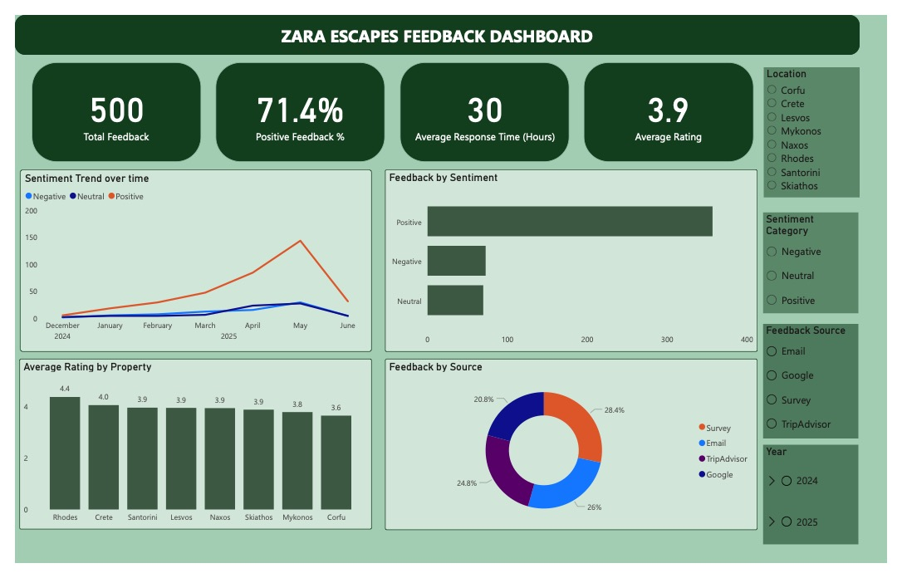
Final Prototype
Centralized dashboard enabling faster decision-making
Notes:
Demonstrate how the final dashboard empowers managers.

Slide 14

Business Value
Faster response, improved CX, consistent service quality
The refined centralized feedback system directly translates technical and process improvements into measurable business value for Zara Escapes. Each system capability was designed to address a specific operational challenge and deliver practical outcomes that improve both guest experience and internal efficiency.
1. Faster Response Times
2. Improved Customer Experience (CX)
3. Consistent Service Quality Across Properties
4. Summary: From System Capability to Business Value
By linking system design directly to operational outcomes, the centralized feedback system enables Zara Escapes to move from reactive service recovery to proactive, consistent, and guest-centric operations.
Notes:
Link system improvements to tangible business outcomes.

Slide 15

Next Steps
Production rollout, training, continuous optimization
By following these next steps—Production rollout, Structured training, Stabilization, and Continuous optimization—Zara Escapes can successfully transition from prototype to production. The approach ensures that the feedback system delivers lasting value, supports consistent service quality across all properties, and enables proactive guest experience management.
Notes:
Outline recommended next steps toward implementation.

Slide 16

PROJECT READY!
Project ready for implementation and rollout
Notes:
Thank stakeholders and open for questions.

